Slide 1
Digital Portfolio
STUDENT NAME: VIVITHA SRI PS
REGISTER NO AND NMID: 2428B0367,
87105B2E34F3AF0B8FE47AD55A5510EB
DEPARTMENT: BSc.COMPUTER SCIENCE WITH DATA ANALYTICS
COLLEGE: KPR COLLEGE OF ARTS SCIENCE AND RESEARCH

Slide 2
PROJECT TITLE
VOLUNTEER WORK AND SOCIAL SERVICE

Slide 3


AGENDA
Problem Statement
Project Overview
End Users
Tools and Technologies
Portfolio design and Layout
Features and Functionality
Results and Screenshots
Conclusion
Github Link
3/21/2024 Annual Review

Slide 4

PROBLEM STATEMENT
The goal of this project is to design and develop a simple, informative, and interactive webpage that highlights the importance of volunteer work and social service. The webpage should provide users with an overview of volunteer activities, list different types of social services, and motivate users by displaying inspirational quotes about volunteering through a clickable button. This project aims to promote awareness of social responsibility while allowing beginner developers to practice fundamental web development skills using HTML for structure, CSS for styling, and JavaScript for interactivity.

Slide 5

PROJECT OVERVIEW
The Volunteer Work and Social Service webpage project is designed to create an engaging and educational online platform that promotes the value of volunteering and community service. This project combines basic web technologies—HTML for content structure, CSS for visual styling, and JavaScript for interactivity—to deliver a user-friendly experience. The webpage provides information about different types of volunteer activities and social services, encouraging users to get involved. Additionally, it features a motivational quote generator that inspires users with meaningful messages about the impact of giving back. Overall, this project serves as both a tool for raising social awareness and a practical exercise for developing foundational web development skills.

Slide 6

WHO ARE THE END USERS?
The primary end users of the Volunteer Work and Social Service webpage are individuals who are interested in contributing to their communities and learning more about volunteering opportunities. This includes students, young professionals, and community members looking to get involved in social causes. Additionally, educators and nonprofit organizations may use the webpage as a resource to motivate and inform people about different types of social service activities. Beginner web developers and learners can also benefit from this project as a practical example to build and showcase their coding skills while promoting a positive message. Overall, the webpage is designed for anyone seeking inspiration and information about volunteerism and social responsibility.

Slide 7

TOOLS AND TECHNIQUES
This project utilizes fundamental web development tools and techniques to create an informative and interactive webpage. HTML is used to structure the content, including headings, paragraphs, lists, and buttons, providing a clear and organized layout. CSS is applied to style the webpage, enhancing its visual appeal through colors, fonts, spacing, and responsive design elements. To add interactivity, JavaScript is used to handle user actions, such as clicking a button to display random motivational quotes about volunteering. The combination of these technologies ensures that the webpage is both functional and engaging. Additionally, best practices like semantic HTML and clean code organization are followed to improve accessibility and maintainability.

Slide 8
POTFOLIO DESIGN AND LAYOUT
The design and layout of the Volunteer Work and Social Service webpage are clean, user-friendly, and visually balanced to ensure a pleasant browsing experience. The page begins with a clear and welcoming header that introduces the purpose of the site. Below this, well-structured sections provide information about the importance of volunteer work and outline various types of social service activities in a simple list format. The layout also includes an interactive section with a prominently placed button that displays motivational quotes to inspire users. Soft colors, readable fonts, and organized spacing are used throughout to maintain a calm and professional appearance. The layout is responsive and can easily be integrated into a personal portfolio to showcase both technical skills and social awareness.
8

Slide 9
FEATURES AND FUNCTIONALITY
The Volunteer Work and Social Service webpage offers a range of features and functionalities aimed at informing and inspiring users. It includes a descriptive section that highlights the importance of volunteerism, along with a structured list of various social service activities such as community clean-ups, teaching, and healthcare support. One of the key interactive features is a button that, when clicked, displays a randomly selected motivational quote related to volunteering, providing encouragement and inspiration. The webpage is styled with CSS to ensure a clean and visually appealing layout, and it is built using responsive design principles to work well on different screen sizes. Overall, the functionality focuses on delivering a smooth, educational, and uplifting user experience.

Slide 10
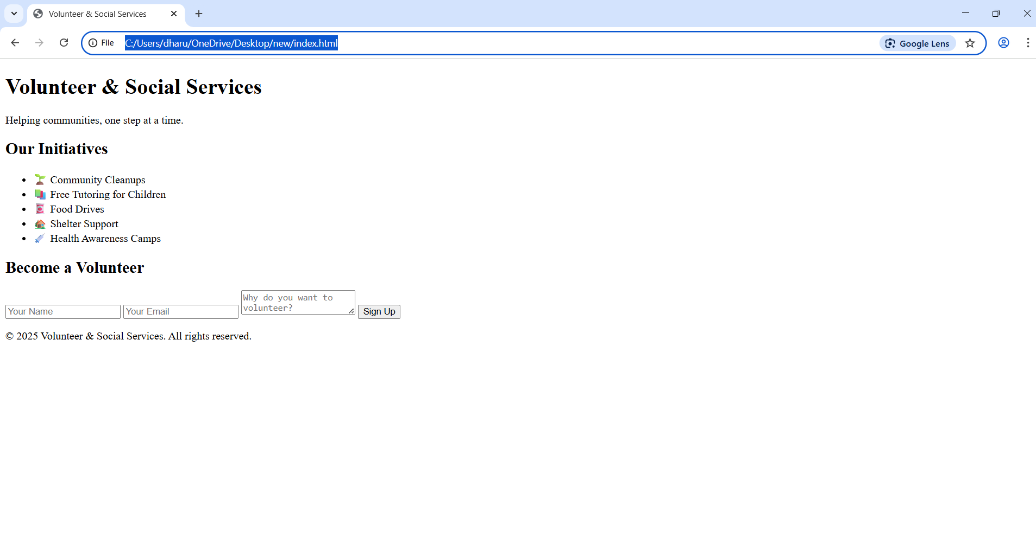

RESULTS AND SCREENSHOTS
3/21/2024 Annual Review
10

Slide 11
CONCLUSION
In conclusion, the Volunteer Work and Social Service webpage is a simple yet meaningful project that combines technical learning with social awareness. It provides users with valuable information about different forms of community service while offering inspiration through interactive motivational quotes. By using HTML, CSS, and JavaScript, the project demonstrates foundational web development skills in a real-world context. Its clean design, clear structure, and user-friendly interface make it an ideal addition to a personal portfolio. Overall, the project not only promotes the importance of giving back to society but also serves as a practical exercise in building functional and engaging web content.
11

Slide 12
GITHUB LINK
https://vivithaparamasivan139-cell.github.io/Vivitha/

